Slide 1
Mad Science:
Hand-Colored Printmaking
Karl Stephan, Visiting Artist | Ms. Groenstein, Art | Academy of Aerospace & Engineering

Slide 2
Relief Printmaking (from Wikipedia)
A printmaking process where protruding surface faces of the printing plate or block are inked; recessed areas are ink free. Printing the image is therefore a relatively simple matter of inking the face of the matrix and bringing it in firm contact with the paper. A printing-press may not be needed as the back of the paper can be rubbed or pressed by hand with a simple tool such as a brayer or roller.
The matrix in relief printing is classically created by starting with a flat original surface, and then removing (e.g., by carving) away areas intended to print white. The remaining areas of the original surface receive the ink.
The relief family of techniques includes woodcut, metalcut, wood engraving, relief etching, linocut, and some types of collagraph.
Traditional text printing with movable type is also a relief technique.

Slide 3
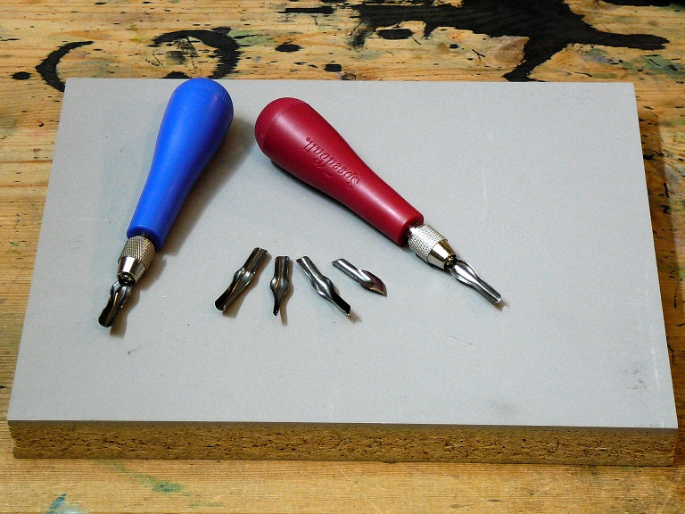
The Matrix
An uncut linoleum block with linocut tools.

Slide 4
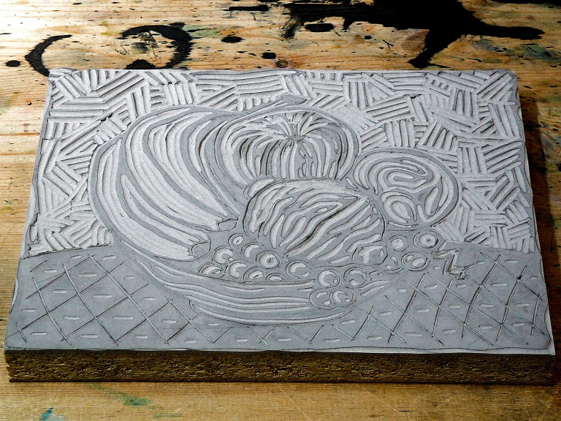
Ready to Print
The carved linoleum block matrix ready to be inked.

Slide 5
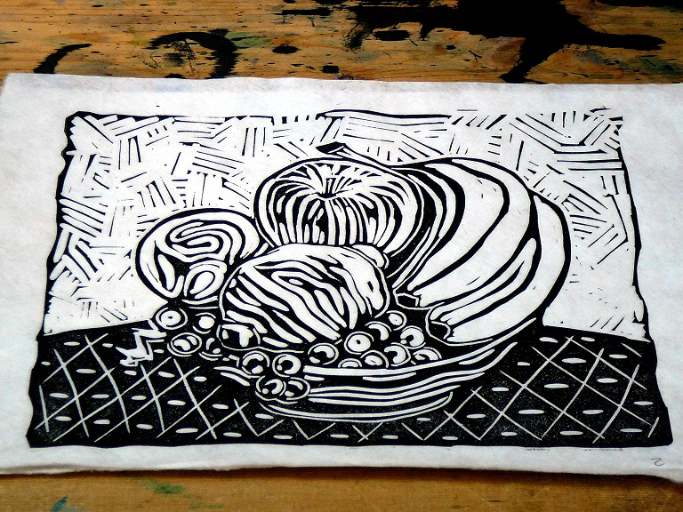
The Print
“Bowl of Fruit” Linocut © Karl Stephan 2014. All rights reserved.

Slide 6
“How can we introduce visually interesting color into relief prints made with just one block?”
Traditional multi-colored prints require one block per color which is time-consuming and adds expense.
Notes:
This is the question that your experiment answers

Slide 7
What we know…
Hand-coloring black and white prints often yields “coloring book” results.
The natural “flow” of watercolors provides for beautiful organic effects.
It is possible to print over dried watercolor without damaging the color.
Notes:
Summarize your research in three to five points.

Slide 8
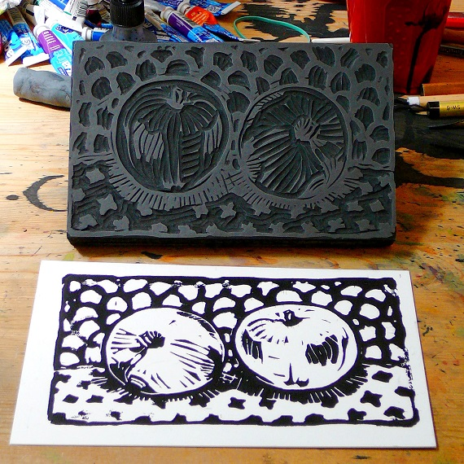
“Them Apples”
Hand-Colored Linocut – Step 1
Carve the block and print on shirt cardboard. HINT: Use simple shapes, outline and pattern - leave space for color!

Slide 9
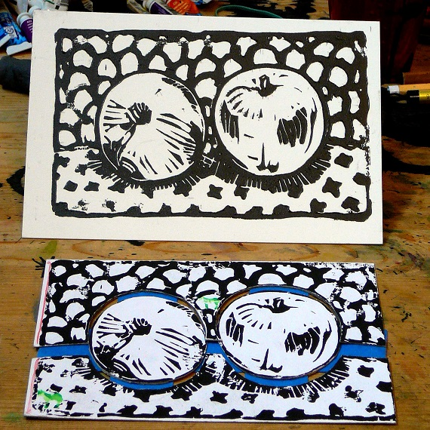
“Them Apples”
Hand-Colored Linocut – Step 2
Cut out the cardboard elements to create a template for tracing.

Slide 10
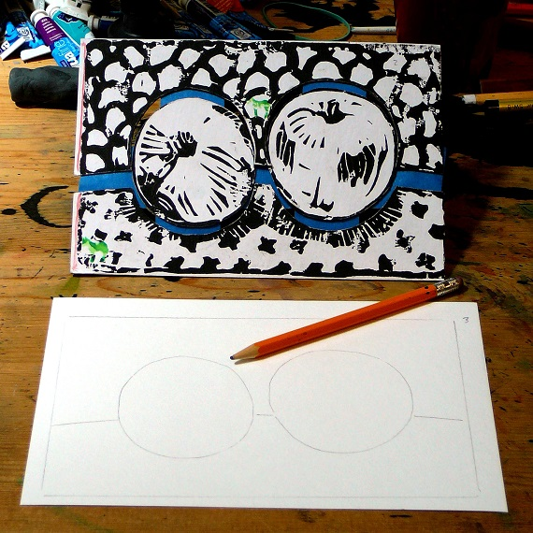
“Them Apples”
Hand-Colored Linocut – Step 3
Create an outline drawing in pencil by tracing the cardboard elements on watercolor paper. NOTE: Be sure to trace the outer edges as well.

Slide 11
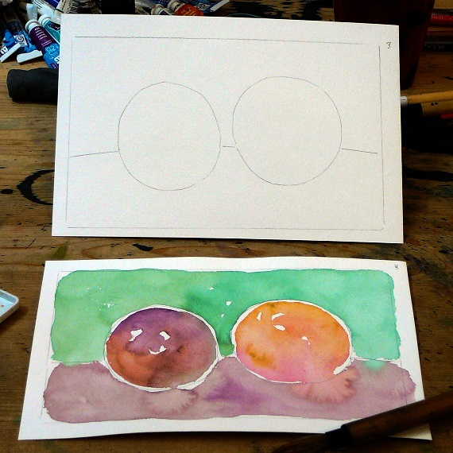
“Them Apples”
Hand-Colored Linocut – Step 4
Fill in the outline drawing with watercolor. HINT: Let the colors flow and don’t be afraid to mix!

Slide 12
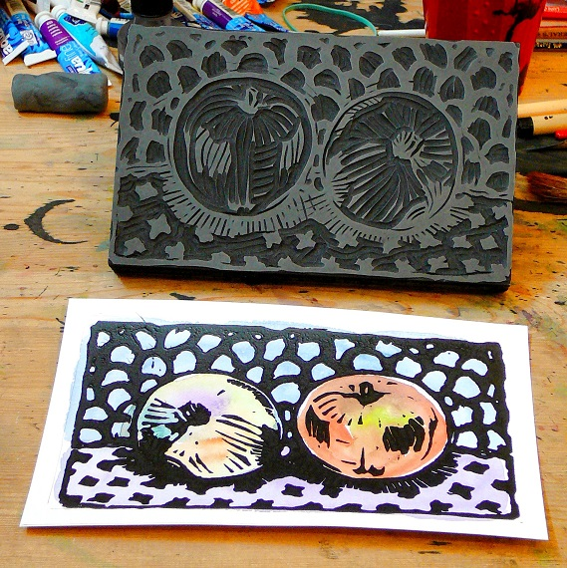
“Them Apples”
Hand-Colored Linocut – Step 5
Print over the dried watercolor using the original block. NOTE: use the outer edges you traced to line up (register) your printing block.

Slide 13
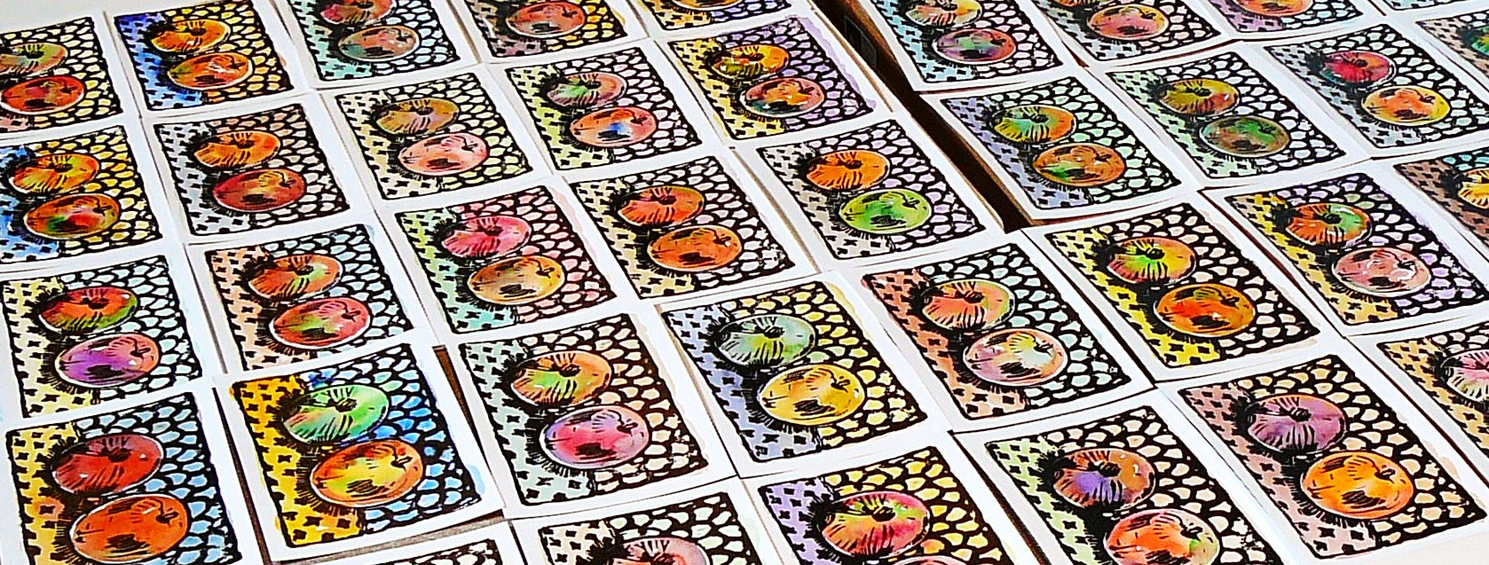
Each one is the same yet every one is different…

Slide 14
Notes on the Printmaking Tradition
Your teacher and my good friend Ms. Groenstein is a superbly talented artist and educator. Treasure her and learn all you can! Printmaking is an ancient skill handed on from one generation to another. She is handing it to you.
I was fortunate to be mentored by artist Roy Nydorf, is one of the great printmakers in the world today. Roy in turn studied at Yale with Gabor Peterdi who wrote the book on printmaking – a book called “Printmaking: Methods Old and New.” I even met Mr. Peterdi as a student and received a print.
I believe I am the only artist in the world using the hand-colored linocut technique shown in this presentation. It is based on knowledge given to me by artists I’ve been fortunate to know. Just as freely, I am giving it to you. Welcome to the great tradition of printmaking!

Slide 15
Thank You!

